Slide 1
Indirect Cost Recovery (ICR) Funds: Allocation and Distribution Model
1/27/2023 ● Can Saygin ● Richard Wilson
2/7/2023 ● Can Saygin ● Michael Mueller ● Richard Wilson
2/8/2023 ● Can Saygin ● Janna Arney
2/10/2023 ● Can Saygin ● Mike Hocker
2/16/2023 ● Deans Research Council (DRC)

Slide 2
“Allocation” of 30% to Generating Units
To Department/Unit
(X%) x (7%) x (F&A Revenue)
Reporting Unit
(X%) x (7%) x (F&A Revenue)
To VP Division
(X%) x (2%) x (F&A Revenue)
Investigator’s Academic Department under an Academic College
Based on investigator appointment
Investigator’s Academic College
Academic Affairs
To “Faculty” Investigator
(X%) x (7%) x (F&A Revenue)
OR
Investigator’s Department
?
OR
OR
School of Medicine
OR
X %
Departments and ORUs do not compete for “credit”. Departments always receive credit due to “faculty appointment” and if a ORU is added, it receives credit, too. We do not “add” Depts and ORUs credit in the same pot to avoid double counting.
Investigator’s Non-Academic Unit
Investigator’s VP Unit
Any other VP Unit
Investigator’s Shared Credit % (represents intellectual contribution to the project)
ROUTING
Proposal
Budget w/ Indirect Rate
Award
Expenditure
w/ F&A Revenue
AND
ORU Reports to a College
Investigator
Include Organized Research Unit (ORU)
OR
?
ORU
?
ORU Reports to Research
OR
To ORU
(X%) x (7%) x (F&A Revenue)
ORU Reports to VP-x

Slide 3
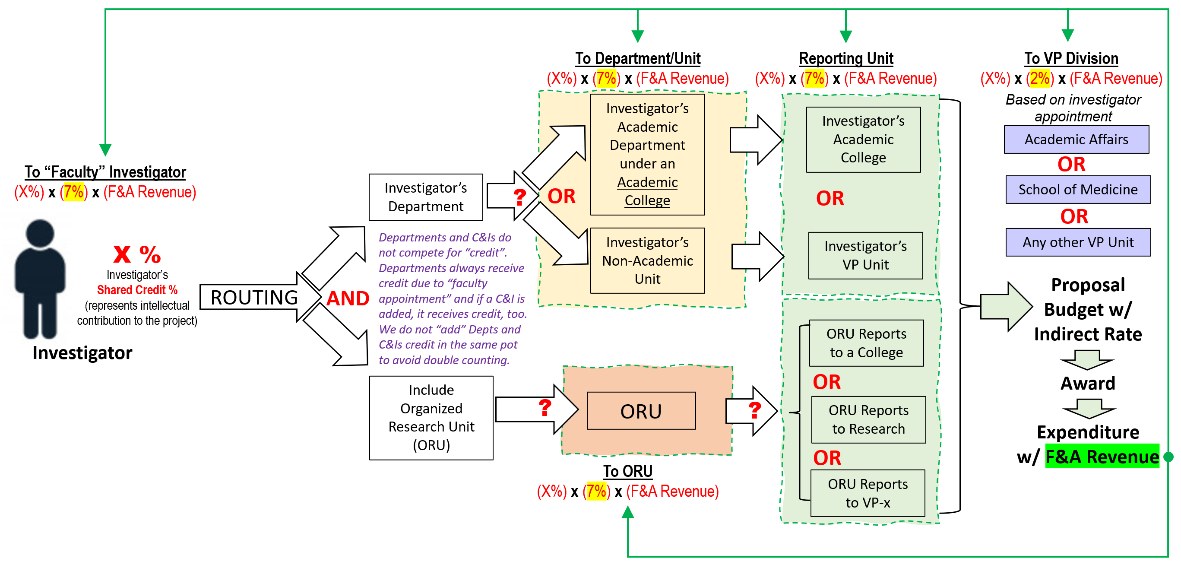
“Distribution” of 30% to Generating Units
7% is directly distributed to “Faculty” investigators’ cost centers
2% is directly distributed to VP level units based on investigator’s appointment
21% is directly distributed to the Deans, including 7% Department and 7% ORU shares to be allocated by each Dean based on performance of the departments and ORUs. A detailed report on F&A earned by Departments at 7% and ORUs at 7% will be provided to Deans as a reference. It is up to the Dean to adjust actual distribution, which may differ from IDC earned. As part of 21%, each Dean will have college level 7%.
If there is no ORU involved in the project, then the 7% will be distributed to the Research Division for research initiatives and enhancements.

Slide 4
Allowed
Faculty Start Up packages.
Cost Share on sponsored projects.
Shared equipment that cannot be easily allocated.
Support (salary, stipend, tuition,…) for graduate and undergraduate research assistants or staff engaged in research activities.
Research related travel for faculty or student researchers to attend professional meetings or to funding agencies.
Purchase of computers or other equipment and/or software to support research.
Repair of research equipment and computers.
Submission fees for peer-reviewed journals.
Purchase of publications or subscriptions to academic journals for which the UTRGV library does not have a subscription.
Support for activities related to obtaining additional funding such as proposal development.
Membership in Research Societies, the purchase of research-related publications (books, subscriptions to research journals) and publication costs.
Travel costs to support external speakers on research topics.
Business meal expenses and meetings with external research collaborators.

Slide 5
NOT Allowed
Entertainment expenses not related to a research objective, e.g., group outings and holiday parties
Travel unrelated to research
Donations to charity or organizations
Teaching supplies or equipment unless it is part of a research project

Slide 6
Moving Forward
The plan is to revisit the IDC Revenue Allocation and Distribution model every 3 years to make sure we make adjustments to allocations as needed by the institution.
The current plan presented in this document is valid for the IDC revenue generated in FY23, FY24, and FY25.
In Sept2025-Aug20206 period, we will revisit the model for the next three years: FY26, FY27, and FY28.

